Slide 1

Machine Learning Training
Kevin Lee MS, Director of Data Science

Slide 2
Agenda
Introduction of Machine Learning
Machine Learning Concepts – Hypothesis function, Cost function, Gradient Descent, Learning Rate
Machine Learning Types – Supervised and Unsupervised
Machine Learning Algorithms – Classification, Regression, Linear Regression, Decision Tree, Clustering
Artificial Neural Network (ANN)
Definition
Impact
Structures – input layers, hidden layers, output layers
Parameters – weights, biases
Hyperparameters - activation function, learning rate
Deep Neural Network (DNN)
Convolutional Neural Network (CNN)
Recurrent Neural Network (RNN)
Current/Future Machine Learning Implementation

Slide 3
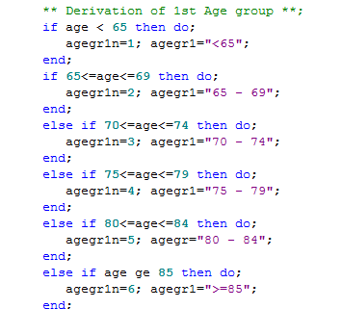
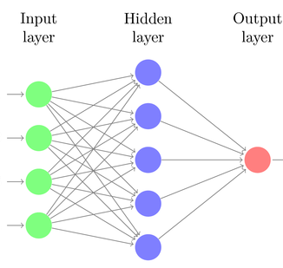
Machine Learning Introduction
What is Machine Learning? - An application of artificial intelligence (AI) that provides systems the ability to automatically learn and improve from experience without being explicitly programmed.
Difference
Explicit programming:
rule-based programming
Machine Learning:
using data and algorithm

Slide 4

How does Human Learn?
- Experience

Slide 5
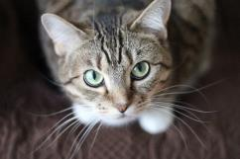

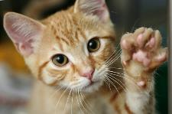

How does Machine learn?
Test Data (cats)
cat
Algorithm
Real Data
Notes:
In Machine Learning, Machine learns very similar ways. However, machine learns through data and algorithm.

Slide 6
How does Machine Learning work?
Algorithm
Hypothesis Function - h_{θ}(x) = θx + b
Minimize Cost Function to find optimum parameters (θ,b),
J(θ) = h_{θ}(x) – Y, using Gradient Descent
Input & output
X₀ | X₁ | X₂ | … | Xn | Y
0 | 17 | 250 |  | 29 | 1
34 | 134 | 22 |  | 57 | 0
72 | 169 | 167 |  | 89 | 0
22 | 34 | 220 |  | 9 | 0
52 | 227 | 235 |  | 69 | 1
Notes:
So, the way that ML works is that we put the data into Machine. And Machine uses algorithms, hypothesis function and cost function. So, let’s talk more in detail about Machine Learning Algorithm since it is a little different from statistical analysis.

Slide 7
Machine Learning Functions
Hypothesis function
Algorithm/Model for data
Linear Regression, Logistic Regression, Support Vector Machine, Decision Tree, Artificial Neural Network
h_{θ}(x) = θ₀x₀ + θ₁x₁ + θ₂x₂ + θ₃x₃ +,, + θ_{n}x_{n} (e.g., Y = 2x + 30)
Parameters : θ₀, θ₁, θ₂ , θ₃,,,θ_{n}
Cost function
To measure how well hypothesis function fits into data.
Difference between actual data point and hypothesized data point. (e.g., Y – h_{θ}(x))
J(θ_{0,} θ_{1,} θ_{2,,}θ_{n}) = (1/2m)*sum[(Y - H)^2]
Gradient Descent
Engine that minimizes cost function
Repeat
Θ₀ := θ₀ – alpha* d/dθ₀ * J(θ_{0,} θ_{1,} θ_{2,,}θ_{n})
Θ₁ := θ₁ – alpha* d/dθ₁ * J(θ_{0,} θ_{1,} θ_{2,,}θ_{n})
Learning rate (alpha) – size of learning step in gradient descent
Notes:
Through Gradient Descent, Machine is able to find the best hypothesis function by minimizing cost function using Gradient Descent.

Slide 8
Machine Learning Project Workflow
Identify the problems to solve
Acquire necessary data
Transform and clean data
Prepare train data and validation data
Select an algorithm
Train an algorithm with train data
Validate the trained model with validation data
Solve the problems/predict with the validated model
Notes:
Through Gradient Descent, Machine is able to find the best hypothesis function by minimizing cost function using Gradient Descent.

Slide 9
Machine Learning Project Workflow
Step | Project Workflow | Example
1 | Identify the problems to solve | Find the pattern between survival days vs drug exposures
2 | Acquire necessary data | Obtain ADSL, DS and EX
3 | Transform and clean data | Prepare ADSE
4 | Prepare train data and validation data | Prepare ADSE_T and ADSE_V
5 | Select an algorithm | Import a linear regression algorithm (sklearn.linear_model)
6 | Train an algorithm with train data | Train selected a linear regression algorithm with ADSE_T
7 | Validate the trained model with validation data | Validate the trained model with ADSE_V
8 | Solve the problems/predict with the validated model | Use the validated model to predict survival days vs drug exposures
Notes:
Through Gradient Descent, Machine is able to find the best hypothesis function by minimizing cost function using Gradient Descent.

Slide 10
ML Project Workflow of Data and Algorithm
ADSL
DS
EX
ADSE
ADSE_T
ADSE_V
Real Data – Number of Drug Exposure
Linear Regression Algorithm h_{θ}(x) = θx
Trained Model
h_{θ}(x) = 2x
Validated Model
h_{θ}(x) = 2x
Predicts Survival Days

Slide 11
ML Algorithm Training with Test Data
In ADSE_T,
Y = Survival Days in months
X = number of drug exposures
Algorithms – Linear Regression (h_{θ}(x) = θx)
Y6 4 2 0
0 1 2 3 X

Slide 12
Hypothesis Function and Cost Function
Y6 4 2 0
J(θ)
Cost function : J(θ)=(1/2m)*sum[(Y - H)^2]
J(1) =(1/6)*sum((2-1)^2 + (4-2)^2 + (6-3)^2) = 14/6
15
10
5
0
h_{θ}(x) = x at θ = 1
0 1 2 3 X
0 1 2 3 θ

Slide 13
Cost Function in different Parameters
J(θ)
J(0) =56/6 = 9.333
J(1) =14/6 = 2.333
J(2) =0/6 = 0
J(3) =14/6 = 2.333
J(4) =56/6 = 9.333
Optimum θ is 2 –Best fitted model is H = 2X.
Question – How can Machine find the optimum θ?
15
10
5
0
0 1 2 3 4 θ

Slide 14
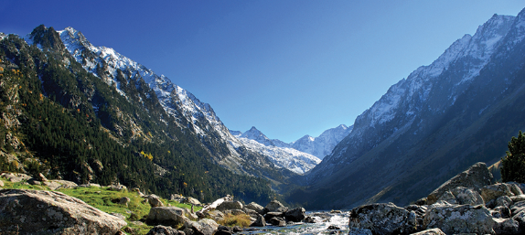
Gradient Descent
Definition – Engine that minimize cost function.
The process of getting to the lowest error value (optimum cost function)
It is like walking down to the valley in the mountain to find the gold located in valley.

Slide 15
Cost function with Gradient Descent
J(θ₁)
Take the derivative of cost function since it will give the direction to move forward : d/dθ₁ J(θ₁)
Make steps down the cost function : θ₁ := θ₁ – d/dθ₁ J(θ₁)
The size of steps is determined by learning rate : θ₁ := θ₁ – alpha* d/dθ₁ J(θ₁)
15
10
5
0
0 1 2 3 4 θ₁

Slide 16
Cost function with Gradient Descent
J(θ₁)
θ₁ := 0 – alpha* d/dθ₁ J(0)
θ₁ := θ₁ – alpha* (negative number)
15
10
5
0
θ₁ := 4 – alpha* d/dθ₁ J(4)
θ₁ := θ₁ – alpha* (positive number)
θ₁ := 3 – alpha* d/dθ₁ J(3)
0 1 2 3 4 θ₁

Slide 17
Learning Rate
J(θ₁)
At Θ₁ := θ₁ – alpha* d/dθ₁J(θ₁) at θ₁ =4.
If the learning rate (alpha) = 0.1, Θ₁ := 4 - 0.1*2 = 3.8 assuming d/dθ₁J(4) = 2.
If the learning rate (alpha) = 0.5, Θ₁ := 4 – 0.5*2 = 3 assuming d/dθ₁J(4) = 2.
15
10
5
0
0 1 2 3 4 θ₁

Slide 18
Machine Learning in each iteration
At first iteration,
Initial Hypothesis function - h_{θ}(x) = 4x
Cost function - J(θ₁) = (1/2m)*sum[(Y - h)^2] = 1/(2*3)* sum(((2-4)^2 + (4-8)^2 + (6-12))^2)) = 56/6=9.333
Gradient Descent – θ₁ := θ₁ – alpha* d/dθ₁ J(θ₁) = 4 – 0.1*2 = 3.8
Final Hypothesis function - h_{θ}(x) = 3.8x
At second iteration,
Initial Hypothesis function - h_{θ}(x) = 3.8x
Cost function - J(θ) = 1/(2*3)* sum(((2-3.8)^2 + (4-7.6)^2 + (6-11.4)^2)) = 45.36/6 = 7.56
Gradient Descent – θ₁ := θ₁ – alpha* d/dθ₁ J(θ₁) = 3.8 – 0.1*2 = 3.6
Final Hypothesis function - h_{θ}(x) = 3.6x
So, the cost function decrease and slope (θ₁) decrease as well.
Y6 4 2 0
hθ(x) = 4x
hθ(x) = 3.8x
hθ(x) = 3.6x
0 1 2 3 X

Slide 19
How Cost function and Gradient Descent find the best model
At each iteration, θ₁ goes to the optimal point.
J(θ₁)
Y6 4 2 0
15
10
5
0
0 1 2 3 4 θ₁
0 1 2 3 X

Slide 20
Model building in Machine Learning
Hypothesis Function
Cost Function Calculation
Applying Gradient Descent
Updating Parameters
New Iteration

Slide 21
Best model can provide best predicted value
Y
Y_{i}
X_{i}
X

Slide 22
Different data, Different model, Different prediction
More data,
Better model,
Better prediction
Y
Y
X
X

Slide 23

Bad data, Bad model, Bad prediction
Y
Garbage in
Garbage out
X

Slide 24
Machine Learning Type
Supervised
Input data labeled : has correct answers
Specific purpose
Types
Classification for distinct output values
Regression for continuous output values
Unsupervised
Input data not-labeled : No correct answers
Exploratory
Types : Clustering (clusters)
X₀ | X₁ | X₂ | … | Xn | Y
X₀ | X₁ | X₂ | … | Xn

Slide 25
Classification
Categorical target
Binary or Classification
Example : Yes/No, 0 to 9, mild/moderate/severe
Logistic Regression, SVM, Decision Tree, Random Forests
X₂
X₁
Notes:
In the right side figure, we can see that there are two type of data. Using Classification Machine Learning algorithm, we can find the pattern.

Slide 26
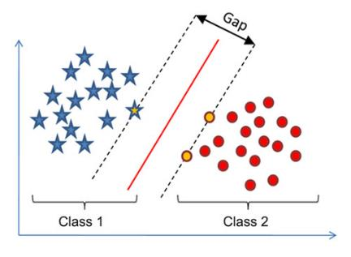
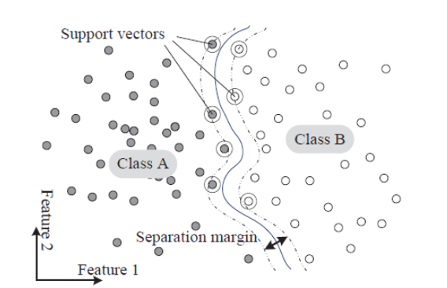
Support Vector Machine (SVM)
SVM is one of the most powerful classification model, especially for complex, but small/mid-sized datasets.
Best for binary classification
Easy to train
It finds out a line/ hyper-plane (in multidimensional space that separate outs classes) that maximizes margin between two classes.
Hyperparameters – Kernel (linear, polynomial), gamma, margin(a separation of line to the closest class points)
Notes:
Kernal=‘linear’ – linear line
C – The larger C, the smaller width.

Slide 27
How SVM works
Identify right hyperplane (line)
Identify right hyperplane (line)
Goals – to minimize distance between support vectors and hyperplane.
Notes:
Kernal=‘linear’ – linear line
C – The larger C, the smaller width.

Slide 28
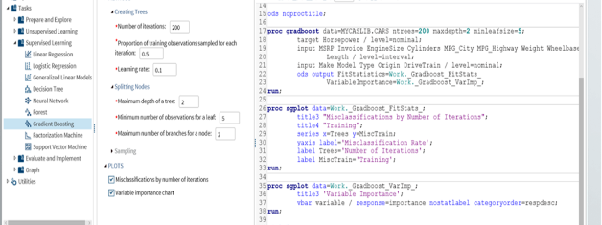
SAS Machine Learning Packages
Where is SAS in ML?
SAS Visual Data Mining and Machine Learning
Linear Regression
Logistic Regression
Support Vector Machine
Artificial Neural Networks ( limited layers)

Slide 29
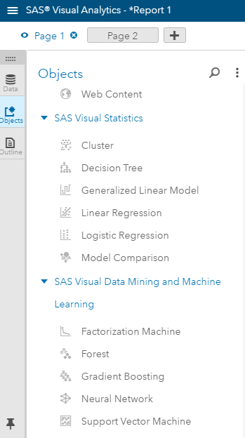
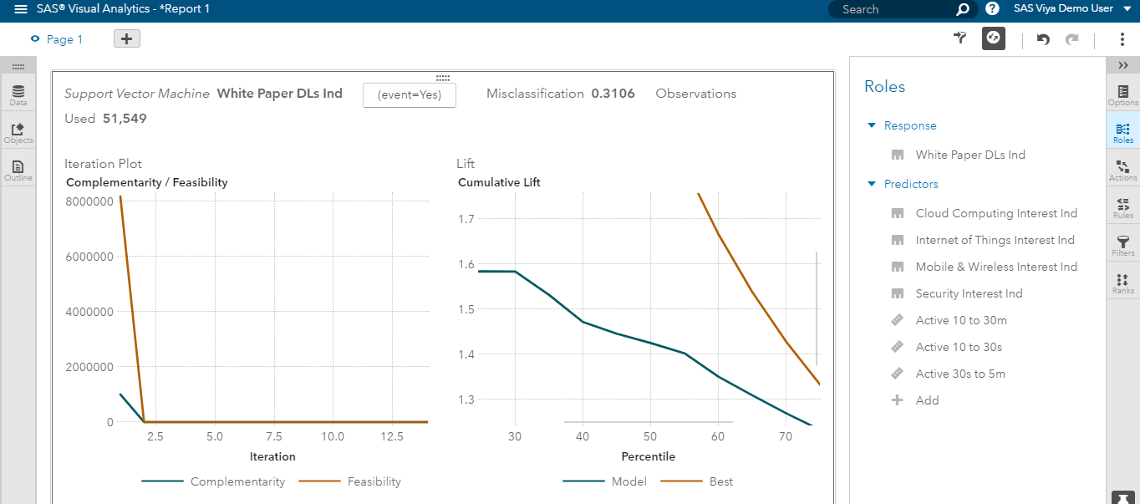
SVM in SAS Visual Data Mining and Machine Learning
*** SVM SAS codes;
proc svmachine data=x_train C=1.0;
kernel linear;
input x1 x2 x3 x4 / level=interval;
target y;
run;

Slide 30
Python in Machine Learning
Most popular programming language in Machine Learning
Scikit-Learn
simple and efficient ML tool, open-source
Classification, Regression, SVM, Clustering, Dimensionality Reduction, Decision Trees, Random Forests
TensorFlow
developed by Google, open source since Nov.’2015
Artificial Neural Network, Convolutional NN, Recurrent NN, Autoencoder, Reinforcement Learning
Keras
The official high-level API of TensorFlow
Easier and more friendly than TensorFlow
Developed by Google and contributed by MS, AWS

Slide 31
Python codes for SVM
#import ML algorithm
from sklearn.svm import SVC
#prepare train and test datasets
x_train = …
y_train = ….
x_test = ….
#select and train model
svm = SVC(kernel=‘linear’, C=1.0, random_state=1)
svm.fit(x_train, y_train)
#predict output
predicted = svm.predict(x_test)
Notes:
Kernal=‘linear’ – linear line
C – The larger C, the smaller width.
Random_state = 1 : random number generator

Slide 32
SVM implementation
Pros:
It works really well with clear margin of separation.
It works well in high dimensional spaces.
It works well where number of dimensions is greater than the number of samples.
Cons:
It requires higher computation power, so it does not work well with larger data.
It also doesn’t perform very well when the data set has a lot of noises.
Notes:
High dimensions – high number of variables

Slide 33
Questions : What is hyperplane for SVM?
Goals – to minimize distance between support vectors and hyperplane.
Notes:
Kernal=‘linear’ – linear line
C – The larger C, the smaller width.

Slide 34
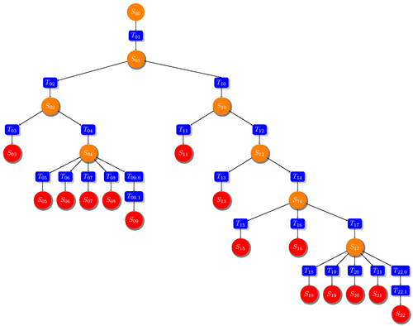
Decision Trees
The widely used machine learning algorithm that use tree to visually and explicitly represent decision and its conditions.
Why Decision Trees?
Easy to understand and interpret
Require a very little data preparation
Possible to validate model using statistical tests.

Slide 35
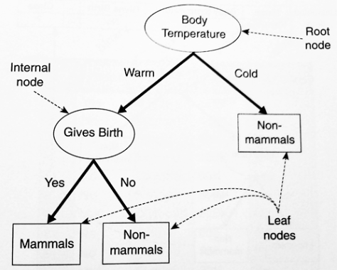
Decision Trees Architecture
Root node – the topmost node in a tree
Internal nodes - condition
Branches – results from condition
Splitting - a process of dividing a node into two or more sub-nodes.
Leaf nodes (decision) – the end of the branch that does not split any more
Hyperparameters that you need to set in Decision Trees Models
Maximum number of features(variables)
Depth of branches – min / max
Criteria – the measure of quality of a split (gini / information gain)

Slide 36
Decision Trees Use Cases
Problems to solve – What is the condition of patients who survived?
ADSL dataset
features (input variables)
SEX
AGE
TRTFL
labels (results)
DTHFL
Decision Trees find out the conditions.
Questions?: internal nodes, edges, leaf nodes
Is SEX “M”?
Yes
No
Is AGE > 65?
DTHFL=“N”
Yes
No
DTHFL=“Y”
Is TRTFL “Y”?
Yes
No
DTHFL=“N”
DTHFL=“Y”

Slide 37
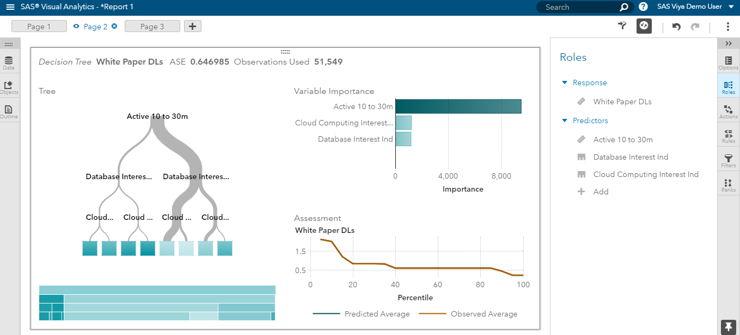
Decision Tree in SAS Visual Data Mining and Machine Learning
PROC HPSPLIT data = ADAE maxleaves=100
maxbranch = 4 leafsize=1 ;
model Y(event=‘y’) = x1 x2 x3 x4;
Run;

Slide 38
Python codes for Decision Tree
#import ML algorithm
from sklearn.tree import DecisionClassifier
#prepare train and test datasets
x_train = …
y_train = ….
x_test = ….
#select and train model
d_tree = DecisionClassifier(max_depth=4)
d_tree.fit(x_train, y_train)
#predict output
predicted = d_tree.predict(x_test)
Notes:
Kernal=‘linear’ – linear line
C – The larger C, the smaller width.
Random_state = 1 : random number generator

Slide 39
Logistic Regression
Output: Binary target (Yes/No)
Input: Continuous/categorical variables
Example : predicting if the tumor is malignant based on tumor size
Malignant?
Malignant?
Yes
(1)
Yes (1)
Threshold : 0.5
No (0)
Tumor size (mm)
No (0)
Tumor size (mm)

Slide 40
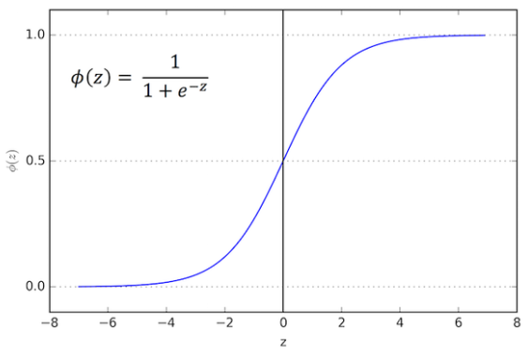
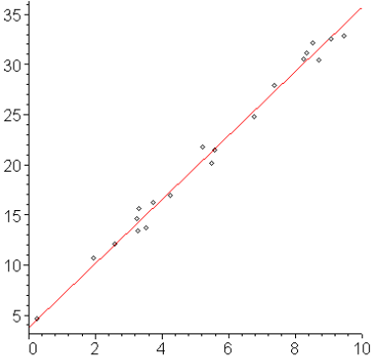
Logistic Regression
(Logistic + Regression)
Logistic function: Sigmoid function, which describe properties of population growth in ecology, rising quickly and maxing out at the carrying capacity of the environment. Any real-valued number and map it into a value between 0 and 1, but never exactly at those limits.
Regression function: a set of statistical processes which estimate the relationships among variables. It indicates the relationship how the dependent variable changes when any one of the independent variables is varied, while the other independent variables are held fixed. z = θ₀x₀ + θ₁x₁ + θ₂x₂ + θ₃x₃ +,, + θ_{n}x_{n}

Slide 41
Logistic Regression Architecture
Hypothesis function : h_{θ}(x) = 1 / (1 + e^{-z}) where z= ( θ₀x₀ + θ₁x₁ + θ₂x₂ + θ₃x₃ +,, + θ_{n}x_{n} )
x₁
θ₁
x₂
θ₂
∑
z
f(z)
h_{θ}(x)
x₃
θ₃
What are the parameters?
θ_{n}
x_{n}
θ₀

Slide 42
Logistic Regression Exercise
Hypothesis function : h_{θ}(x) = 1 / (1 + e^{-z})
where z= ( 2x₀ + x₁ + 5x₂ + 6x₃ +0.5x₄ )
Put the parameters
Calculate z and h_{θ}(x) if x = (0.1, 2, 0.2, 0.4) assuming x₀ = 1
x₁
x₂
∑
z
f(z)
h_{θ}(x)
x₃
x₄

Slide 43
Python codes for Logistic Regression
#import ML algorithm
from sklearn.linear_model import LogisticRegression
#prepare train and test datasets
x_train = …
y_train = ….
x_test = ….
#select and train model
lr = LogisticRegression()
lr.fit(x_train, y_train)
#predict output
predicted = lr.predict(x_test)
Notes:
Kernal=‘linear’ – linear line
C – The larger C, the smaller width.
Random_state = 1 : random number generator

Slide 44
Regression
y
To predict values of a desired target quantity when the target quantity is continuous.
Output: Continuous variables
Example : predicting house price per sqft
Types: Linear Regression, Polynomial Regression
Hypothesis function:
h_{θ}(x) = θ₀x₀ + θ₁x₁ + θ₂x₂ + θ₃x₃ +,, + θ_{n}x_{n}
y = 10 + 2x
x

Slide 45
Python codes for ML Linear Regression
#import ML algorithm
from sklearn import linear_model
#prepare train and test datasets
x_train = …
y_train = ….
x_test = ….
#select and train model
linear = linear_model.LinearRegression()
linear.fit(x_train, y_train)
#predict output
predicted = linear.predict(x_test)

Slide 46
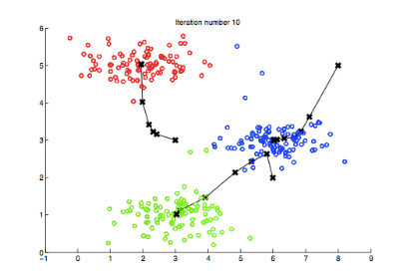
Unsupervised Machine Learning
Input data not-labeled – no correct answers
Exploratory
Clustering – the assignment of set of observations into subsets (clusters) so that data in the same clusters are more similar to each other than to those from different clusters.
Algorithms – k-means
Industry implementation – the grouping of documents, music, movies by different topics, finding customers that share similar interests based on common purchase behaviors.

Slide 47
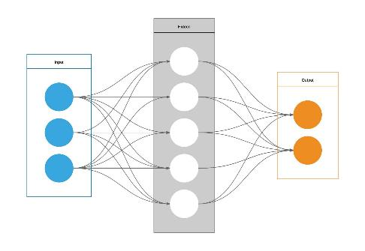
Artificial Neural Network (ANN)
Most powerful ML algorithm
Game Changer
Works very similar to human brain – Neural Network
Types – DNN, CNN, RNN
Architecture
Artificial Neurons
Input Layers
Hidden Layers
Output Layers
Activation Functions

Slide 48
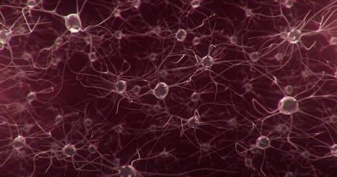
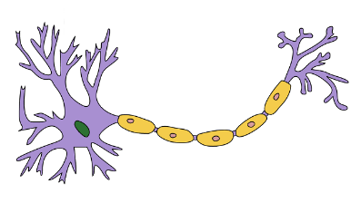
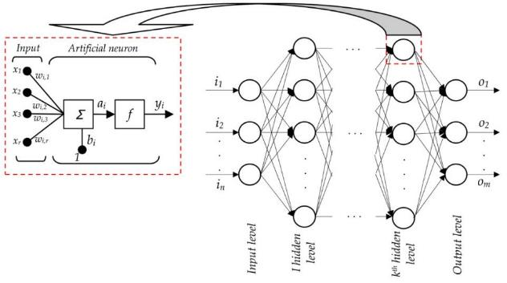
Human Neural Network vs Artificial Neural Network (ANN)
Human Neurons : Neural Network – 100 billions
Artificial Neurons : Artificial Neural Networks
Notes:
Artificial neural network works very similarly as human neural network.
Each machine neuron receives input and collect data together and process those data in activation function and provide outputs. In overall artificial neural network, each neuron works in a harmony with other neurons.

Slide 49
Artificial Neuron
x₁
W_{1,1}
x₂
W_{1,2}
∑
z₁
Activation function
a₁
x₃
W_{1,3}
W_{1,n}
x_{n}
b₁
Input (x₁, x₂, x₃,,,,x_{n}) – numeric values that goes into neuron model
Weight (w₁, w₂, w₃,,,,w_{n}) – weight of each input values
Bias (b₁) – bias of input* weight
Artificial neuron
Model (input values * weights + bias): z₁ = x₁w_{1,1} + x₂w_{1,2} + x₃w_{1,3} +,,,, + x_{n}w_{1,n} + b₁
Activation function : a₁ = f(z₁)

Slide 50
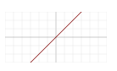
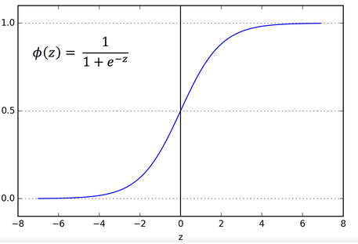
Activation Functions
Introduction – a node that is added to the output of NNs. Sometime, it could be added between two NNs.
Purpose – to provide boundary of outputs.
Linear function
f(x) = ax + b
Ex. Regression
Sigmoid or Logistic function
f(x) = 1 / (1 + e^{-x})
Ex. Logistic Regression, DNN, CNN
Purpose – to predict the probability as an output since it exists between 0 and 1

Slide 51
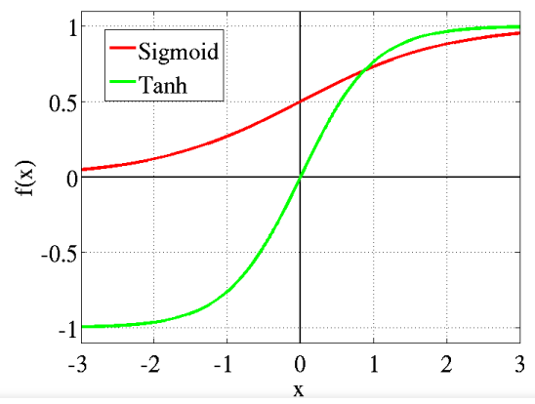
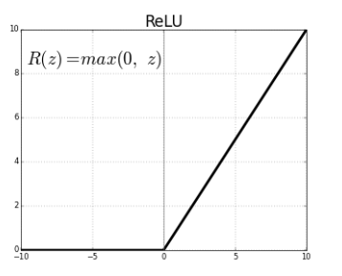
Activation Functions
Tanh or Hyperbolic Tangent function
f(x) = tahn(x) = 2 / (1 + e^{-x}) – 1
Ex. RNN
mainly used for classification between two classes
ReLU (Rectified Linear Unit) function
f(x) = 0 for x < 0 ; x for x>= 0
Ex – CNN, DNN
the most used activation function in the world right now
Speeding up the computation

Slide 52
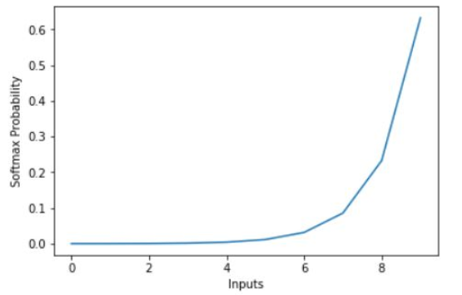
Activation Functions
Softmax function
f(x_{i}) = e^{-xi} / sum(e^{-x})
Unlike Sigmoid, the sum does not need to add up to 1
Usage – RNN
To provide the probability of a given output. The model will select the best probability.
Text Sensitivity Analysis – read texts and predict the mood of text
Output | Sad | Fine | Happy | Very Happy
Softmax function | 0.02 | 0.2 | 0.89 | 0.43

Slide 53
Artificial Neuron - example
W = [0.00045, 00056, 0.00077, 0.00606]
x₁
z₁ = w₁*x₁ + w₂*x₂ + w₃*x₃ + w₄*x₄ + b₁ =0.98371
a₁ = sigmoid(z₁) = 0.727844
255
231
94
112
w₁
x₂
w₂
∑
z₁
Sigmoid (activation function)
a₁
w₃
0.98371
x₃
0.727844
w₄
x₄
b₁
0.002

Slide 54
What “Artificial Neuron” learns
x₁
w₁
x₂
w₂
∑
z₁
Activation function
a₁
x₃
w₃
w₄
x₄
b₁
Machine Learning – To learn parameters
Weights (w₁, w₂, w_{3,}w₄)
Bias (b₁)
How many parameters in this neuron?

Slide 55
How “Artificial Neuron” learns
x₁
w₁
x₂
dz₁=y₁-a₁
w₂
∑
Activation function
x₃
w₃
w₄
x₄
b₁
Cost function of ANN (actual output – predicted value) is J(w ,b) = (1/m)* sum [ℓ(y₁ – a₁)]
Gradient descent/optimization
w := w – alpha*dJ/dw
b := b – alpha*dJ/ db

Slide 56
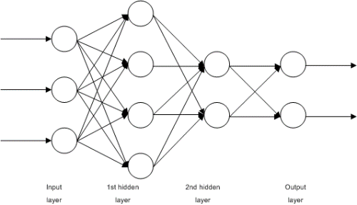
ANN Architecture
Input layer - 3 features (variables)
Hidden layer
Hidden layer1 - 4 neurons
Hidden layer2 - 2 neurons
Output layer – 2 outputs
How many weights at hidden layer 1? 3*4 = 12
How many weights at hidden layer 2? 4*2 = 8
How many weights at output layer? 2*2 = 4
How many biases at hidden layer 1? 4
How many biases at hidden layer 2? 2
How many biases at output layer? 2
How many parameters all together? (12+4) + (8+4) + (4+2) = 34

Slide 57
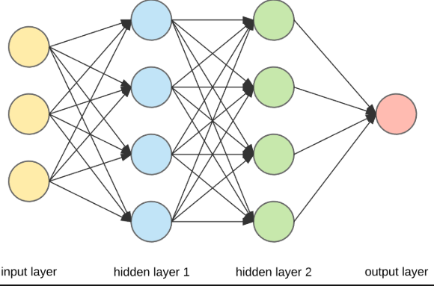
ANN Architecture Exercise
How many input variables?
How many weights at hidden layer 1?
How many weights at hidden layer 2?
How many weights at output layer?
How many biases at hidden layer 1?
How many biases at hidden layer 2?
How many biases at output layer?
How many parameters all together?

Slide 58

Deep Neural Network (Deep Learning)
DNN is the aggregates of individual artificial neurons.
Basic architecture - Input layer, Hidden layer, Output layer.
Every layer is made up of a set of neurons, which each layer is fully connected to all neurons in the layer before.

Slide 59
DNN example
To detect whether patients will have cancer or not
Input variables– age, sex, race, weight, height, family history
Outcome – yes/no
To detect numbers from 0 to 9 from image
Input variables – 28 by 28 pixel image
Outcome – 0, 1,2,,,,, 9
To detect AE events from text message
Input variables – texts, comments from social media
Outcome - AE or not
To detect sensitivity from text message
Input variables – blogs, comments from social media
Outcome - “Very unhappy”, “Unhappy”, “Happy”, “Very happy”

Slide 60
Deep Learning Project Workflow
Step | Project Workflow | Example
1 | Identify the problems to solve | Find the pattern of data
2 | Acquire necessary data | Obtain data
3 | Transform and clean data | Prepare data for Deep Learning
4 | Prepare train data and validation data | Prepare train data and validation data
5 | Select an algorithm and hyperparameters | Select features(variables), number of hidden layers, number of neurons in each layer, activation function, learning rate and other parameters.
6 | Train an algorithm with train data | Train the selected model with train data
7 | Validate the trained model with validation data | Validate the trained model with test data
8 | Solve the problem/predict with the validated model | Use the validated model to predict.
Notes:
Through Gradient Descent, Machine is able to find the best hypothesis function by minimizing cost function using Gradient Descent.

Slide 61

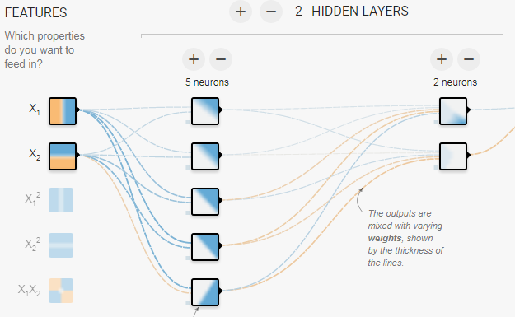
Tensor Flow Demo
http://playground.tensorflow.org

Slide 62
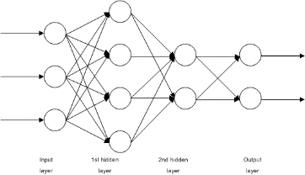
Python codes for DNN
#import ANN - TensorFlow
import tensorflow as tf
X = tf.placeholder(..)
Y = tf.placeholder(..)
hidden1 = tf.layer.dense(X, 4, activation=tf.nn.relu)
hidden2 = tf.layer.dense(hidden1, 2, activation=tf.nn.relu)
logits = neuron_layer(hidden2, 2)
….
loss = tf.reduce_mean(….)
optimizer = tf.train.GradientDescentOptimezer(0.1)
training_op = optimizer.minimizer(loss)
tf.Session.run(training_op, feed_dict={X:x_train, Y:y_train})

Slide 63
Convolutional Neural Network (CNN)
Image-specific Artificial Neural Network – image search/recognition, face recognition, face verification, self-driving and more
Its concept comes from brain visual cortex where many neurons have a small region of the visual field (in CNN, filter)
The name of CNN comes from “convolution”, one of the most important operation in CNN.
The first Convolutional Neural Network is LeNet-5, which can classify digits from hand-written number.
Advantage compared to DNN
2 or 3 dimensional read (image rather than vector)
Less parameters, much less computing power

Slide 64
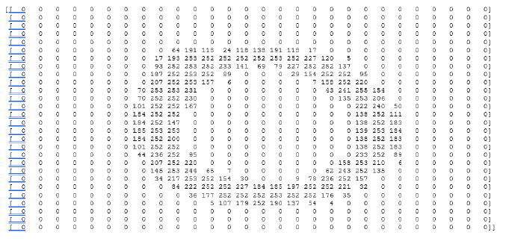

Image Data
When the computer see the image, it sees pixel values.
Image data in .png is “0”. It is 28 by 28 pixels.
This can be converted into 28 by 28 number.

Slide 65

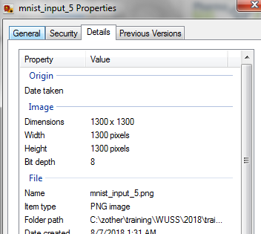
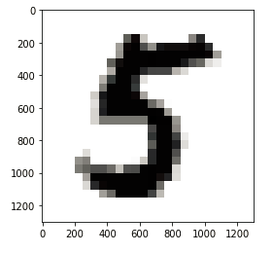
Example
Python codes
image_5 =imread(fname='./images/mnist_input_5.png')
print('Shape of Image 5 : ', image_5.shape)
print(image_5)
Shape of Image 5 : (1300, 1300)
[[255 255 255 ... 255 255 255]
[255 255 255 ... 255 255 255]
...
[255 255 255 ... 255 255 255]]
plt.imshow(image_5, cmap="gray")
plt.show()

Slide 66
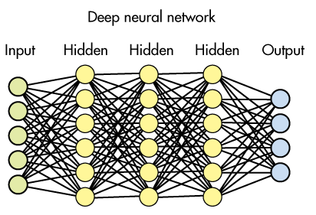
DNN on Images data
₀
₁
₂
₃
₄
₅
₆
₇
₈
₉
x₁
x₂
x₃
x₄
,,,,
x₇₈₃ x₇₈₄
28 by 28 data is converted to 784(28 by 28) features.
784 neurons in input layer
## neurons in hidden layer 1
10 neurons in output layer

Slide 67
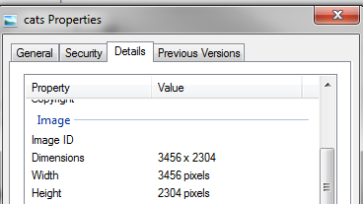
Complex Image data
### import imread function
from skimage.io import imread
image_cat = imread(fname='./images/cats.jpg')
print('Shape of Image cat : ', image_cat.shape)
Shape of Image cat : (2304, 3456, 3), which means 2304 * 4356 * 3 = 30,108,672 features goes into DNN, a way too much computation.

Slide 68
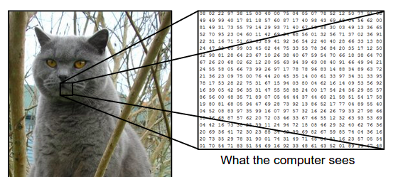
CNN image
Image-specific Artificial Neural Network

Slide 69
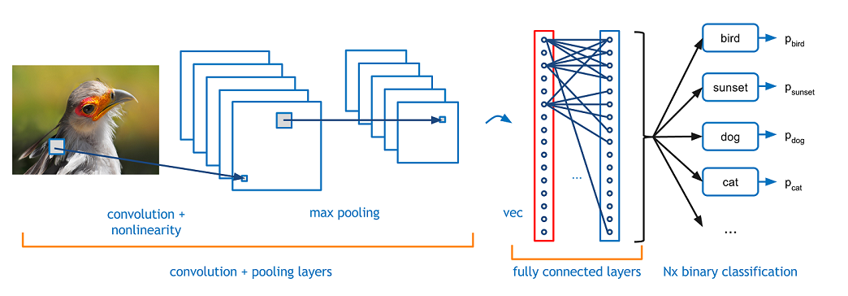
CNN Architecture
CNN Architecture
Input (3 dimensional vector)
Convolution
Pooling
Fully-connected layers
Classification (outputs)

Slide 70
Convolution in CNN
Convolution – the mathematical combination of two functions to produce a third function.
3*1 + 1*1 + 2*1 + 0*0 + 5*0 + 7*0 + 1*-1 + 8*-1 + 2* -1 = -5
3 | 0 | 1 | 2 | 7 | 4
1 | 5 | 8 | 9 | 3 | 1
2 | 7 | 2 | 5 | 1 | 3
0 | 1 | 3 | 1 | 7 | 8
4 | 2 | 1 | 6 | 2 | 8
2 | 4 | 5 | 2 | 3 | 9
-5
-5 | -4 | 0 | 8
-10 | -2 | -4 | -7
0 | -2 | -4 | -7
-3 | -2 | -3 | -16
1 | 0 | -1
1 | 0 | -1
1 | 0 | -1
*
=
parameter - 3 x 3 filter
output - 4 x 4
input - 6 x 6

Slide 71
Filters in Convolution
Filters are feature identifiers ( e.g., straight edges and curves)
Input Image * Filter
If high number, it has that feature identifier.
If low number, it does not have that feature identifier.
1 | 0 | -1
1 | 0 | -1
1 | 0 | -1
1 | 1 | 1
0 | 0 | 0
-1 | -1 | -1
0 | 1 | 1
1 | 0 | 0
1 | 0 | 0
3 | 0 | 1 | 2 | 7 | 4
1 | 5 | 8 | 9 | 3 | 1
2 | 7 | 2 | 5 | 1 | 3
0 | 1 | 3 | 1 | 7 | 8
4 | 2 | 1 | 6 | 2 | 8
2 | 4 | 5 | 2 | 3 | 9
-5
-5 | -4 | 0 | 8
-10 | -2 | -4 | -7
0 | -2 | -4 | -7
-3 | -2 | -3 | -16
1 | 0 | -1
1 | 0 | -1
1 | 0 | -1
*
=
parameter - 3 x 3 filter
output - 4 x 4

Slide 72
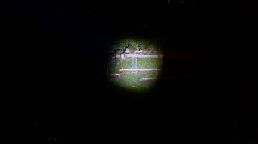
Convolution in image perspective

Slide 73

Pooling in CNN
Pooling with filters of 2 X 2
Max Pooling – more popular than average pooling
Average Pooling
(-5 -4 -10 -2) / 4 = -21/4= -5.25
Pooling progressively reduces the spatial size of the representation to reduce the amount of parameters and computation in the network, and hence to also control overfitting.
-5 | -4 | 0 | 8
-10 | -2 | -4 | -7
0 | -2 | -4 | -7
-3 | -2 | -3 | -16
-2 | 8
0 | -3
-5 | -4 | 0 | 8
-10 | -2 | -4 | -7
0 | -2 | -4 | -7
-3 | -2 | -3 | -16
-5.25 | -0.75
-1.75 | -7.5

Slide 74
Fully-connected layer in CNN
This layer basically takes an input volume (e.g., 7x7x32) and outputs an N (e.g., 10) dimensional vector where N is the number of classes that the program has to choose from.
For example,
The resulting vector for a digit classification program is [0,.1, .1, .75, 0, 0, 0, 0, 0, .05] for number 0 to 9
It represents a 10% probability that the image is a 1, a 10% probability that the image is a 2, a 75% probability that the image is a 3, and a 5% probability that the image is a 9.
Model will predict it is “3”.

Slide 75
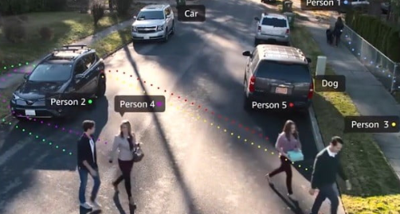
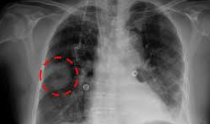
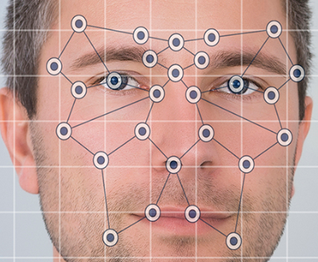
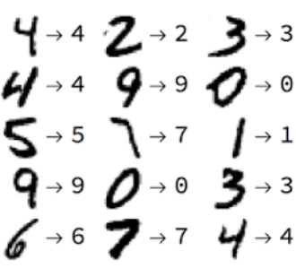
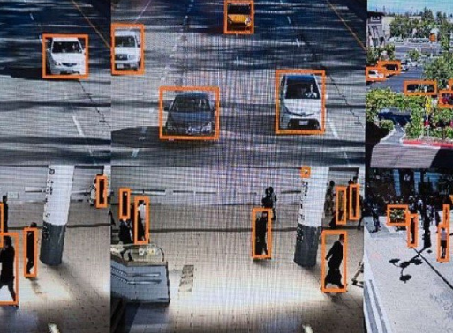
CNN Implementation
One of the most popular DNN
Go-to-model for all the image-related problems
Image Classification
X-ray diagnosis
Face Recognition
Face Verification
Object detection
Autonomous vehicles

Slide 76
Python codes for CNN
From keras.models import Model
From keras.layers import Input, Conv2D, Activation, MaxPooling2D, Flatten, Dense
X = Input(64,64,3)
X1 = Conv2D(64, (7,7))(X) # (32,32,64)
X2 = Activation(‘relu’)(X1)
X3 = MaxPooling2D((2,2))(X2) # (16,16,64)
X4 = Flatten()(X3) # 16*16*64
X5 = Dense(128)(X4) # 128
X6 = Activation(‘relu’)(X5)
Y = Dense(1, activation=‘sigmoid’)(X6) # 1
model = Model(inputs=X, outputs=Y)
model.compile(optimizer=‘adam’, loss=‘binary_crossentropy’)
model.fit(X_train, Y_train, epochs=50)

Slide 77
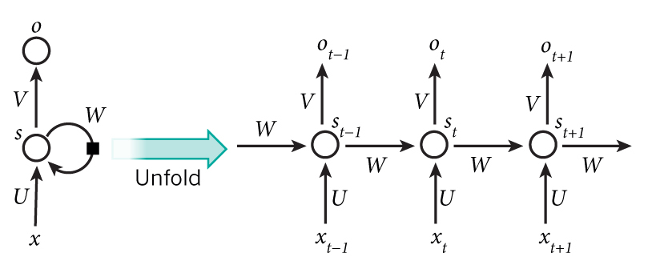
Recurrent Neural Network (RNN) Introduction
Introduction – recurrent neural network model to use sequential information.
Why RNN?
In traditional ANN, all inputs and outputs are independent of each other. But, in some case, they could be dependent.
Some problems such as text analysis and translation, we need to understand which words come before.
RNN has a memory which captures previous information about what has been calculated so far.

Slide 78

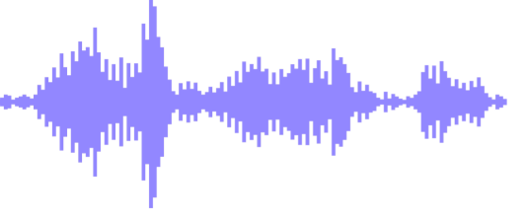

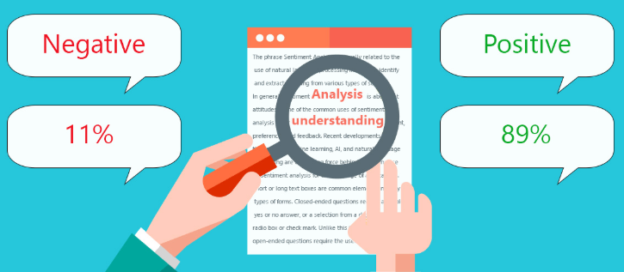
Recurrent Neural Network (RNN) Implementation
Speech Recognition
Music Generation
Sentiment Classification
Machine Translation
Video Activity Recognition
Name Entity Recognition
DNA Sequence Analysis

Slide 79
Basic RNN Structure and algorithm
Y^{<1>}
Y^{<2>}
Y^{<3>}
Y^{<t>}
Wya
a^{<1>}
a^{<2>}
a^{<3>}
a^{<t-1>}
a^{<t>}
a^{<0>}
Waa
Wax
X^{<1>}
X^{<2>}
X^{<3>}
X^{<t>}
a^{<t>} =g(Waa*a^{<t-1>} + Wax*X^{<t>} +ba) when g is an activation function (e.g., tahn, ReLU)
Y^{<t>} =g(Wya*a^{<t>} + by) when g is an activation function (e.g., sigmoid, softmax)
Note that a^{<t>} includes the information from previous X.
If t = 10, how many parameters?

Slide 80
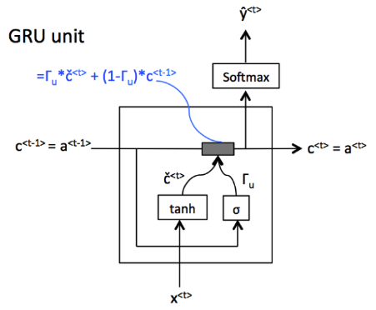
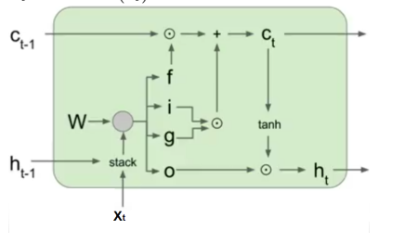
More Complex RNN Structure and algorithm
GRU ( Gated Recurrent Unit) – A gating mechanism in RNN
GRUs have been shown to exhibit better performance on smaller datasets.
GRUs have fewer parameters than LSTM, as they lack an output gate.
LSTM (Long Short-Term Memory Unit)
It is composed of 3 gates – input, forget and output.
LSTM remembers values over arbitrary time intervals and the 3 gates regulate the flow of information into and out of LSTM unit.
LSTMs were developed to deal with the vanishing gradient problems.
Relative insensitivity to gap length is an advantage of LSTM over RNNs.

Slide 81
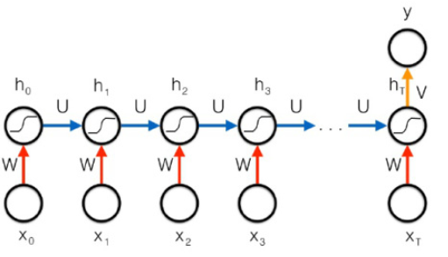
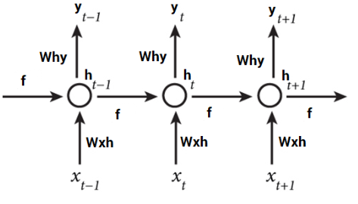
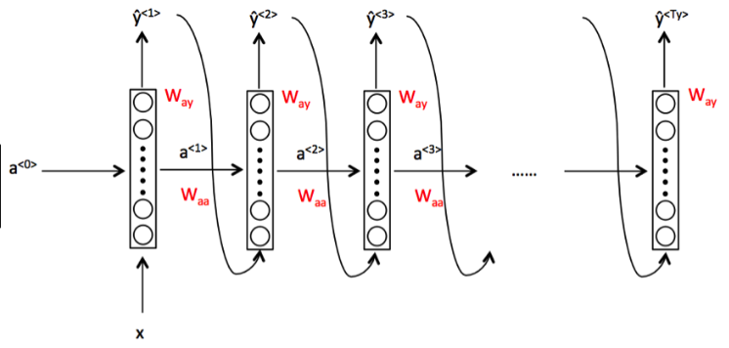

Popular RNN Architecture
Training on Embedding Matrix. Text notation. When # of inputs = # of outputs
Sentimental Analysis (PV signal) x = text, y = 0/1 or 1 to 5
Music generation. Picture Description. x= vector, y = text
Machine translation.
x = text in English, y = text in French

Slide 82

Bidirectional Recurrent Neural Network (BRNN)
Introduction of BRNN– RNN which learns both directions.
Forward and backward learning of the same input.
It reads the whole sentence. A great model of NLP.
Examples
He said, “Teddy bears are on sale!”
He said, “Teddy Roosevelt was a great President!”
Traditional RNN can’t tell the difference between two sentences until Teddy.
BRNN can tell the difference.

Slide 83
Natural Language Processing (NLP) using RNN
Introduction of NLP – An area of artificial intelligence on an interaction between computer and human natural language. ML which programs computers to process and analyze natural language data.
Input data
Embedding – representing each word to vectors of numbers
Glove (Global vectors for word representation)
400K words
Each word represented by 50 dimensional vector
e_{the} - “the” [ 0.418, 0.24968, -0.41242, 0.1217, 0.34527, -0.044457, -0.49688, -0.17862, -0.00066023,,,,, ]
Encoding – using word embedding (e.g., Glove), convert words to 50 dimensional vector.
“I am happy” to [e_{I}, e_{am}, e_{happy}]
Output data
Softmax output [0.01, 0.33, 0.20, 0.73] to outputs [‘very unhappy’, ‘unhappy’, ‘happy’, ‘very happy’] of “very happy”

Slide 84
Simple RNN architecture on NLP
Input data – “I am smiling”, “I laugh now”, “I am crying”, “I feel good”, “I am not sure now”
Embedding – to convert words to vector number
LSTM – to learn language
Softmax – to provide probability of output
Output data - “sad”, “fine”, “happy”, “very happy”
Y = “very happy”
Y
softmax
a^{<0>}
LSTM
a^{<1>}
LSTM
a^{<2>}
LSTM
a^{<3>}
LSTM
a^{<t-1>}
e^{<1>}
e^{<2>}
e^{<3>}
e^{<t>}
embedding
embedding
embedding
embedding
X^{<1>}
X^{<2>}
X^{<3>}
X^{<t>}
“I”
“am”
“smiling”
X = “I am smiling”

Slide 85
Python codes for RNN
From keras.models import Model
From keras.layers import Dense, Input, LSTM, Activation
From keras.layers.embeddings import Embedding
X = Input(10, dtype=‘int32)
embedding_layer = Embedding(400000, 50) # size of word-vector
embedding_layer.set_weights([emb_matrix]) # import from glove.400k.50d.txt
embedding = embedding_layer(X)
X1 = LSTM(10)(embedding)
X2 = Dense(4)(X1) # 4 possible outputs
Y = Activation(‘softmax’)(X2)
model = Model(inputs=X, outputs=Y)
model.compile(loss=‘categorical_crossentropy’, optimizer=‘adam’)
model.fit(X_train, Y_train, epochs=50)

Slide 86
Machine Learning Tools
Program
SAS
SAS tools: SAS Visual Data Mining and Machine Learning in https://www.sas.com/en_us/software/visual-data-mining-machine-learning.html - interactive, visualized, easy to use tools. Paid packages
Procedures in SAS Enterprise Miner : REG, HPSPLIT, NEURAL, HPSVM, HPCLUS,
R
A great scripting language for data manipulation, data visualization and Machine Learning
Packages : caret, nnet, keras, mlr
Python
The most popular Machine Learning scripting language
Packages : sklearn, tensorflow, Keras
Interactive easy to use Tool
IBM Watson
Microsoft Azure Machine Learning Studio
Google Cloud

Slide 87
Difference between Statistics and Machine Learning
Statistics
Sample Size
P-value
Machine Learning
Big Data
Accuracy
Specific models
Any models
Mathematically/statistically proven
Black Box

Slide 88
How Machine Learning is being used in our daily lives
Voice Recognition – Apple’s Siri, Google’s Home Assistant, Amazon’s Alexa
Recommendation – Amazon, Netflix, Spotify
Chatbot – Online customer service
Google Duplex – AI System for accomplishing Real-World Tasks over the phone
Amazon Go – Cashless Grocery Store
AlphaGO – beat “Go” world champion
Terminator “ I will be back”
FDA first approval on ML/AI: Artery’s medical imaging platform to diagnosis heart problem

Slide 89
Why is AI(ML) so popular now?
Cost effective
Automate a lot of works
Can replace or enhance human labors
“Pretty much anything that a normal person can do in <1 sec, we can now automate with AI” Andrew Ng
Accurate
Better than humans
Can solve a lot of complex business problems

Slide 90

How Biometrics can utilize ML/AI in Pharma
Gold mines - Clinical trial data in Pharmaceutical industries
Clean – Pharma companies spent a lot of hours to clean the data.
Unbiased - Prospective study, randomized
Blinded – double-blinded
Standards – CDISC
Structured
Metadata
Pharmaceutical companies already owned the data.

Slide 91
What is the reality of clinical trial data?
Main purpose - for the submission
No or limited analysis after submission
Do not know exactly where clinical trial data is
Limited/No access
No CDR (Central Data Repository)

Slide 92




Clinical Trial Data with ML/AI implementation for Patients/Doctor
Machine Learning/ AI
Patients/ Doctors/ Healthcare Providers
CDISC Clinical Trial Data

Slide 93
Machine Learning Implementation to solve problems
Disease Identification/Diagnosis
Personalized Treatment
Drug Discovery
Manufacturing Automation / Optimization
Clinical Trial Research
Radiology and Radiotherapy
Site Selection
Patient Recruitments
Pharmacovigilance

Slide 94
Adoption of Machine Learning / AI in Pharma
Slow
Regulatory restriction
Machine Learning Black Box challenge – need to build ML models, statistically or mathematically proven and validated, to explain final results.
Status Quo / Change Management
Big investment in Healthcare and a lot of AI Start up aiming Pharma

Slide 95
Now, how Pharma goes into AI/ML market
GSK sign $43 million contract with Exscientia to speed drug discovery
J&J (Surgical Robotics) – partners with Google. Leverage AI/ML to help surgeons by interpreting what they see or predict during surgery
Roche - With GNS Healthcare, use ML to find novel targets for cancer therapy using cancer patient data
Pfizer - With IBM, utilize Watson for drug discovery. Watson has accumulated data from 25 million articles compared to 200 articles a human researcher can read in a year.

Slide 96
Healthcare AI/ML market
US - 320 million in 2016
Europe – 270 million in 2016
40% annual rate
10 billion in 2024
Short in talents
Great opportunities

Slide 97
How can I start/learn “Machine Learning”?
Embrace changes
Starting reading about Machine Learning
Take courses ( online or school)
Exercises
Mimic others
Compete with others (Kaggle)
Start implementing in your organization even if it is a simple implementation

Slide 98
Conclusion
“Medicines and Data Science” company.
Novartis CEO Vas Narasimhan
“The hardest part is starting. Once you get that out of the way, you will find the rest of journey much easier.”
“Secret of getting ahead is getting started”

Slide 99
Thanks!!! Contact klee@clinidatainsight.com for any questions

